Slide 1
Lights Out Management

Slide 2
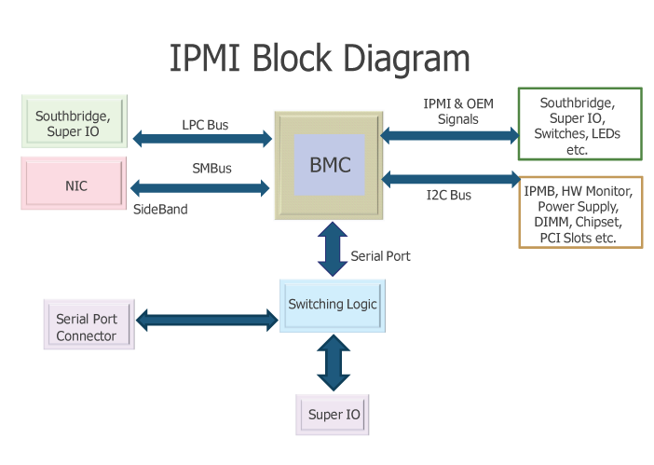
Intelligent Platform Management Interface (IPMI)
Remote management and monitoring
Hardware level
Works with machine powered down
Message based

Slide 3
IPMI
Features
System Monitoring
System temperatures
Voltages
Fans
Power Supplies
Chassis Intrusion
System controls
Power on/off
rebooting
watchdog timer controls
Consoles
Serial interface
KVM over IP

Slide 4
IPMI
Why?
You can watch the administer boot processes remotely
Before SSH is available
Make changes in BIOS remotely
Power cycling of machine remotely
System monitoring
Crude but powerful

Slide 5
IPMI
Interface Types
Serial
not common, but standard allows for it
Out-of-Band
requires a second ethernet connection
Fast enough for video
Side-Band
Shared ethernet connection
Reduced throughput
Fast enough for serial console, but not video

Slide 6
IPMI
Services
Services only required to run on local machine
Running ipmitool on local machine requires root
Service name | ipmi; ipmievd
Packages | OpenIPMI; ipmitool
Related Commands | ipmitool

Slide 7
IPMI
Module Loading
lsmod
View loaded kernel modules
modprobe [module_name]
Load kernel module
/etc/rc.modules
Load kernel module at boot

